Slide 1

IMAGE FUSION
Using DWT and DCT algorithms
Under Guidance of:
Dr. G Ramesh Babu
Submitted by:
K Priyanka 15981A04E5
K S Raja Ganesh 15981A04F0
K Sai Mahesh 15981A04E7
M Bala Chandra 15981A04F7

Slide 2
CONTENTS
Abstract
Introduction
Objective
Methodology
Block diagram
Applications
Conclusion
Softwares
References

Slide 3
ABSTRACT
The objective of image fusion is to combine relevant information from multiple images into a single image. Result of image fusion is a single image which is more suitable for human and machine perception or further Image-processing tasks. The objective in image fusion is to reduce uncertainty and minimize redundancy in the output while maximizing relevant information particular to an application or task. Fusion is an important technique within many disparate fields such as remote sensing, robotics and medical applications. Fused images can provide information that sometimes cannot be observed in the individual input images. Successful image fusion significantly reduces the amount of data to be viewed or processed without significantly reducing the amount of relevant information. This project uses Discrete Wavelet Transform (DWT) algorithm and Discrete Cosine Transform (DCT) in this process. The performance of the algorithms are compared and the experimental results are verified and found the output image qualities are improved.

Slide 4
INTRODUCTION
Due to the limited depth of focus of optical lenses it is not possible to get an image that contains all relevant objects in focus.
However, for accurately interpreting and analyzing images, it is desired to obtain images with every object in focus.
Multifocus image fusion is an effective technique to solve this problem by combining two or more images of the same scene taken with different focus settings into a single all-in-focus image with extended depth of field.
The resultant fused image is very useful for human or machine perception.

Slide 5
OBJECTIVE
To reduce uncertainty and minimize redundancy in the output while maximizing relevant information particular to an application or task.
Result of image fusion is a single image which is more suitable for human and machine perception or further Image-processing tasks.

Slide 6
METHODOLOGY
Discrete Wavelet Transform (DWT)
Discrete Cosine Transform (DCT) + consistency verification

Slide 7
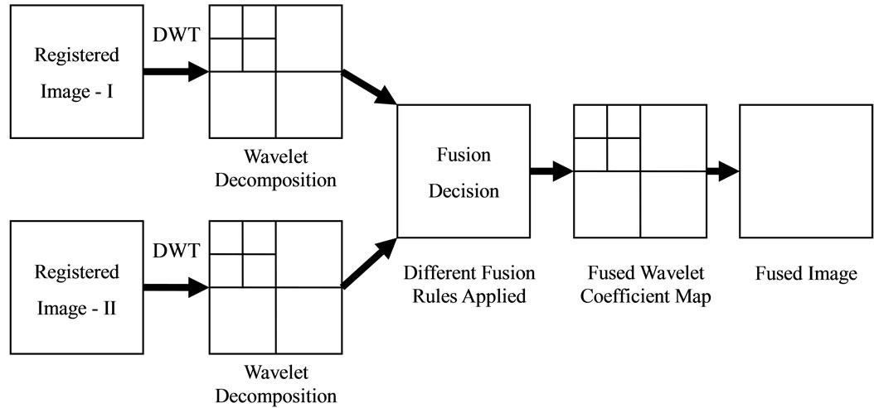
Discrete Wavelet Transform (DWT)

Slide 8
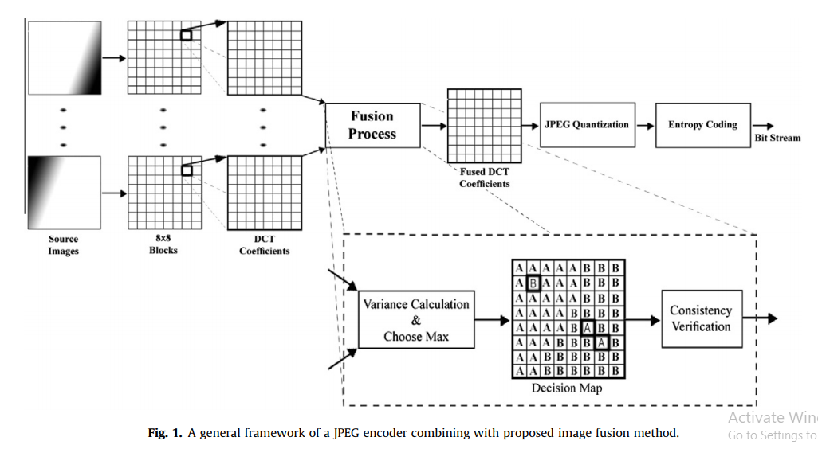
Discrete Cosine Transform (DCT) + consistency verification

Slide 9
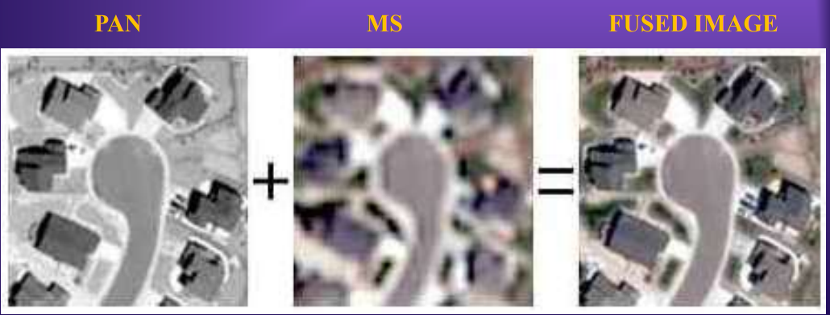
APPLICATIONS
Remote sensing - Image fusion in remote sensing has several application domains. An important domain is the multi-resolution image fusion. In satellite imagery we can have two types of images:
Panchromatic image
Multispectral image

Slide 10
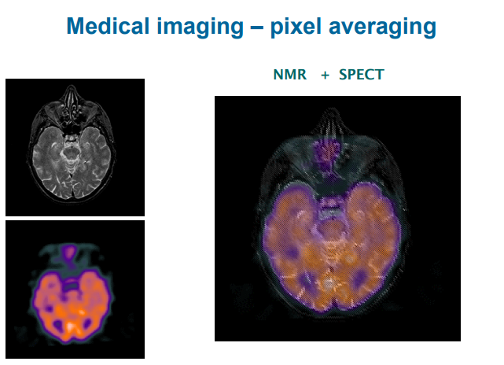
Medical Image Fusion - Image fusion has become a common term used within medical diagnostics and treatment. Fused images may be created from multiple images from combining information from multiple modalities, such as
magnetic resonance image (MRI)
computed tomography (CT)
positron emission tomography (PET)

Slide 11
Conclusion
The comparative study of DWT and DCT Image fusion approaches and the related work was done till now is presented.
It is observed that high spatial resolution is obtained in traditional image fusion techniques which result in image blurring problem.
To overcome these issues wavelet based image fusion technique is proposed. Wavelets provide a high quality spectral content with least spectral distortion.
The DCT fusion method is based on the definition of variance in DCT domain. Simplicity of this method makes it appropriate for real-time applications.
Furthermore, utilization of variance in the proposed algorithm leads to better quality of the fused image.
In this article different transform are applied on pixel level based image fusion and the results are compared using different objective based performance measures.

Slide 12
SOFTWARES
MATLAB – 2018 A

Slide 13
REFERENCES
A Review on Recent Improved Image Fusion Techniques K.C. Rajini, S. Roopa.
Multifocus Image Fusion Using Discrete Wavelet Transform And Sparse Representation Aishwarya N , Abirami S, Amutha R.
Multi-focus image fusion for visual sensor networks in DCT domain Mohammad Bagher Akbari Haghighat ,Ali Aghagolzadeh, Hadi Seyedarabi.

Slide 14
THANK YOU

